Slide 1
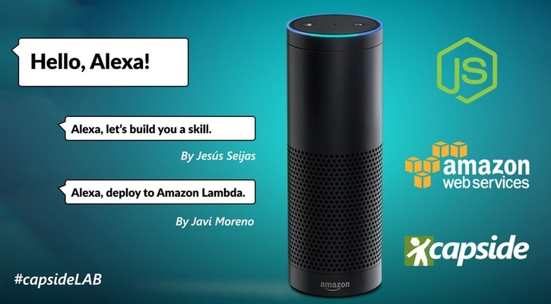

Slide 2

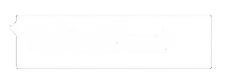
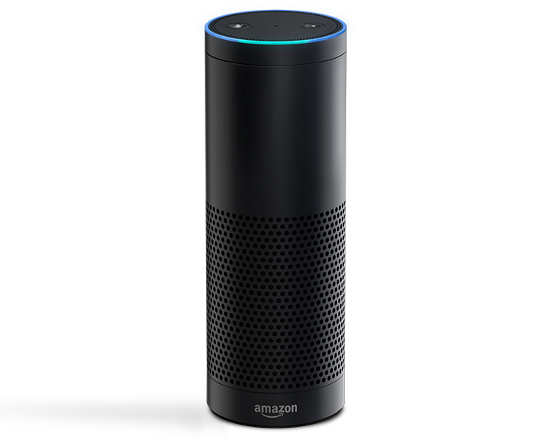

Alexa, who is this guy?
He is Jesús Seijas
His twitter is @jseijasdev
https://github.com/jseijas
He works at AXA Group Solutions

Slide 3
Alexa, which languages
do you speak?
I speak English (US and UK)
Ich spreche Deutsch

Slide 4
Alexa, where are you
available right now?
US, UK and Germany

Slide 5
Alexa, tell me your
history
I was launched in September 2014
I was available in US in June 2015
My API was opened in March 2016
I became available at UK and Germany in September 2016

Slide 6
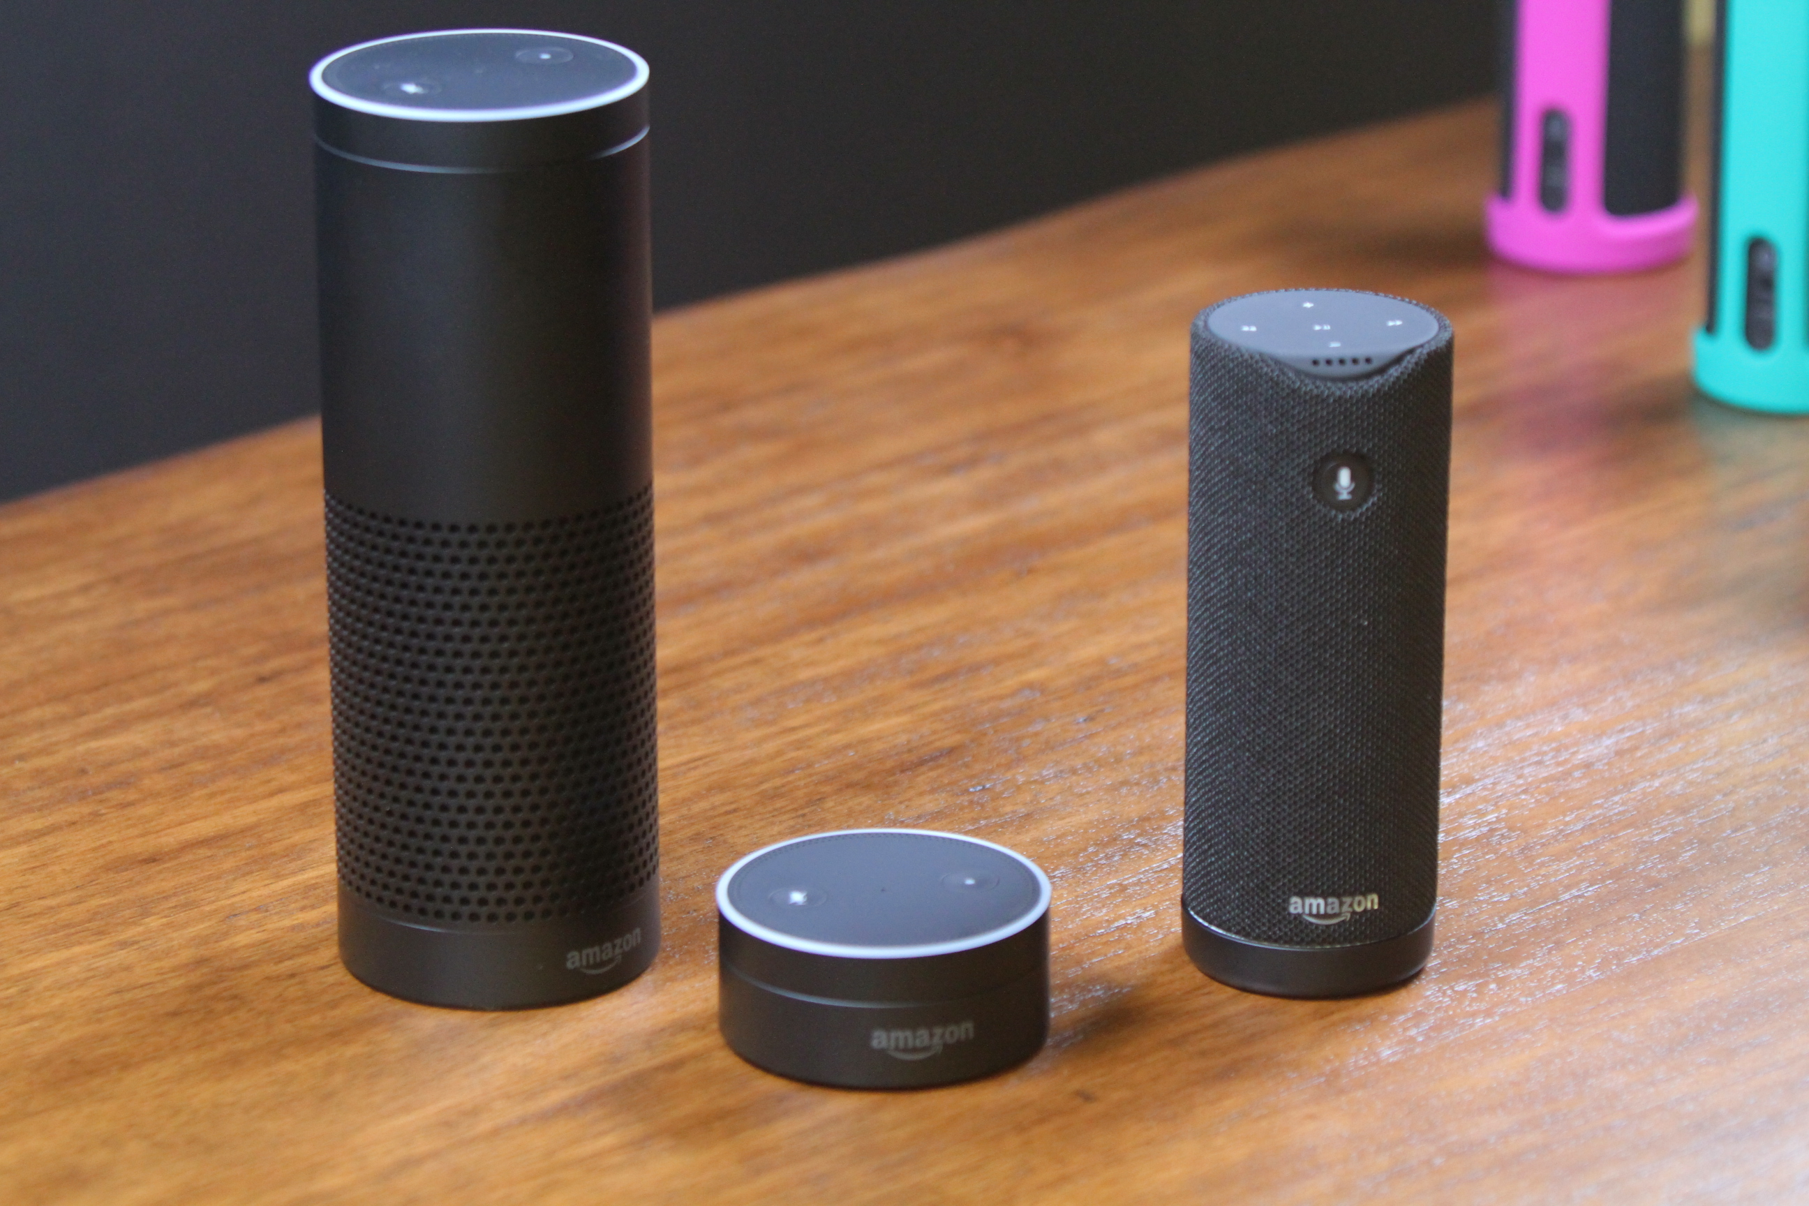

I’m Amazon Echo
I’m Amazon Tap
I’m Amazon Dot

Slide 7
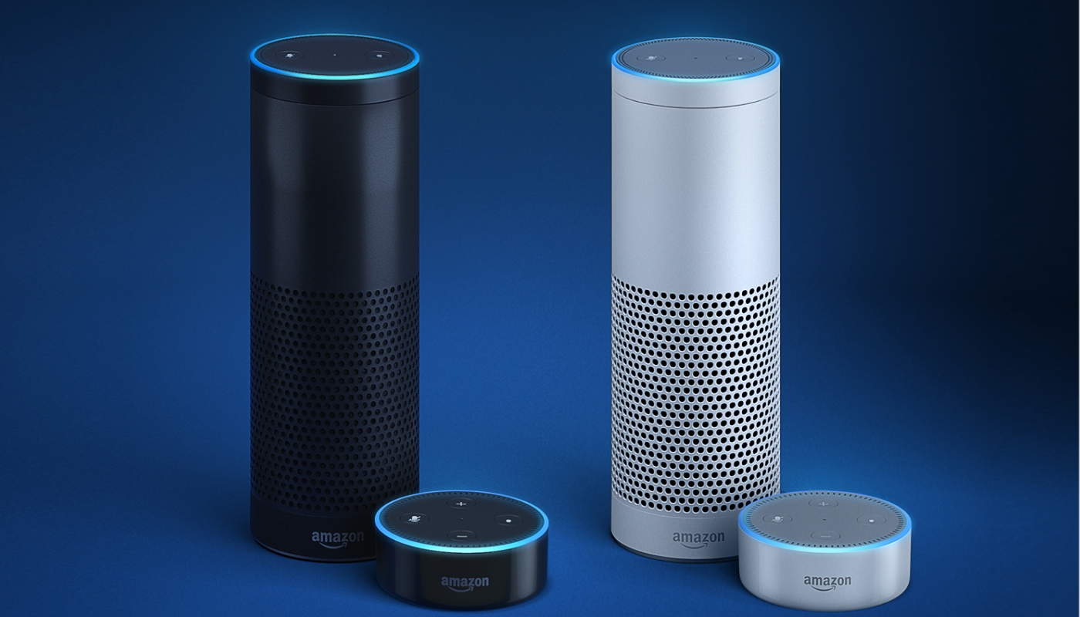
Dark Side
Light Side

Slide 8

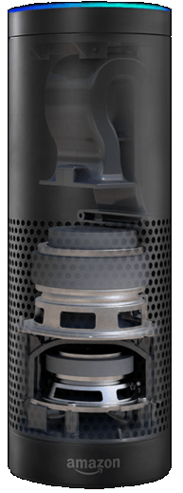
Don’t look! I’m naked!
Reflex Port
Enhances the woofer’s output for
deeper sounds without distortion
2.5 inch woofer
Delivers deep bass response
7 microphone array
2.0 inch tweeter
Crisply hits the high notes

Slide 9
Alexa, do you have
apps?
My apps are called skills
You can add skills from the market
Or develop your own skills

Slide 10
Alexa, what do I need
to start developing?
Install Node:
https://nodejs.org/
Get an Amazon developer account:
https://developer.amazon.com/
You’ll need an IDE:
https://code.visualstudio.com/
Take a picture of this and complete
your installation!

Slide 11
Alexa, how you
understand language?
First at all I have speech-to-text
But every skill understand what he
is trained for.
This is called Natural Language
Processing. Is Machine Learning.

Slide 12
Alexa, explain me more
about NLP
What the user says is called utterance:
I want to go to London tomorrow
The action command is called intent:
travel
The parameters are called entities. But Amazon call them slots.
London, tomorrow

Slide 13
Alexa, explain me your
skill architecture
I will need more than 1 slide.
And also I need to draw things.
Go ahead

Slide 14

This is my ecosystem
Developer
Application
Service
Amazon Alexa Service
Amazon Developer Portal

Slide 15
First at all, you set the
configuration at the portal
Developer
Application
Service
Amazon Alexa Service
Amazon Developer Portal
Configuration:
Application data, intents,…

Slide 16
When the user speaks, I send
the audio stream to the Alexa Service
Developer
Application
Service
Amazon Alexa Service
Audio Stream
Amazon Developer Portal
Configuration:
Application data, intents,…

Slide 17
The Alexa Service interprets the message based on
the configuration. Sends the message to your app.
Developer
Application
Service
Amazon Alexa Service
User intents and argumentss
Audio Stream
Amazon Developer Portal
Configuration:
Application data, intents,…

Slide 18
Your app gives a response. It can include a GUI
Card for the mobile application.
Developer
Application
Service
Amazon Alexa Service
Answer. Can include GUI card.
Amazon Developer Portal

Slide 19
The response is sent to the Alexa device and
rendered as voice.
Developer
Application
Service
Amazon Alexa Service
Answer. Render.
Answer. Can include GUI card.
Amazon Developer Portal

Slide 20
The GUI card (optional) is rendered at the
Mobile device.
Developer
Application
Service
Amazon Alexa Service
Answer. Render.
Answer. Can include GUI card.
Amazon Developer Portal
GUI Card. Render.

Slide 21
Alexa, how can I deploy
my skill?
The best way is to use an AWS Lambda.
Javier Moreno can kill me if I tell more.
You can also host it, you’ll need a trusted
certificate for your endpoint.
One good option for your node apps
is Heroku. It’s Free!

Slide 22
Alexa, while I’m code,
how I can debug?
Good question! You can use a secure
tunnel to localhost.
Get ngrok for free!
https://ngrok.com/

Slide 23
Alexa, I need to start
developing right now
Let’s open the terminal!

Slide 24
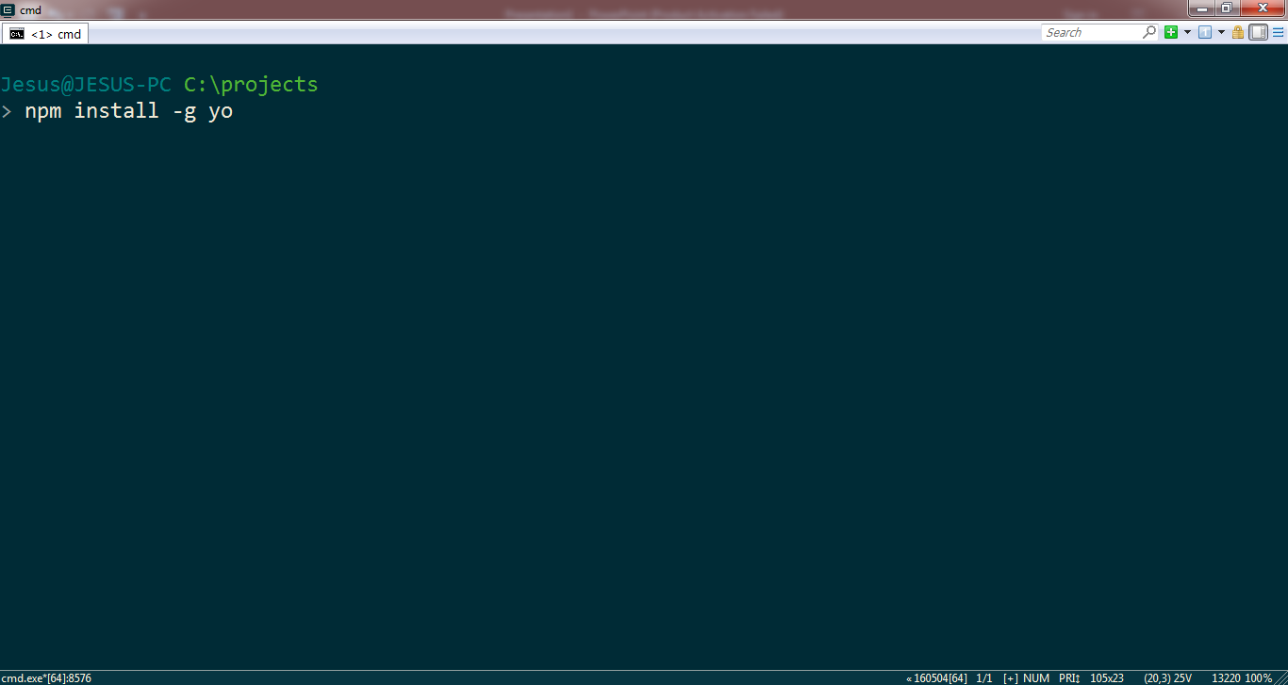
First at all install yeoman.

Slide 25
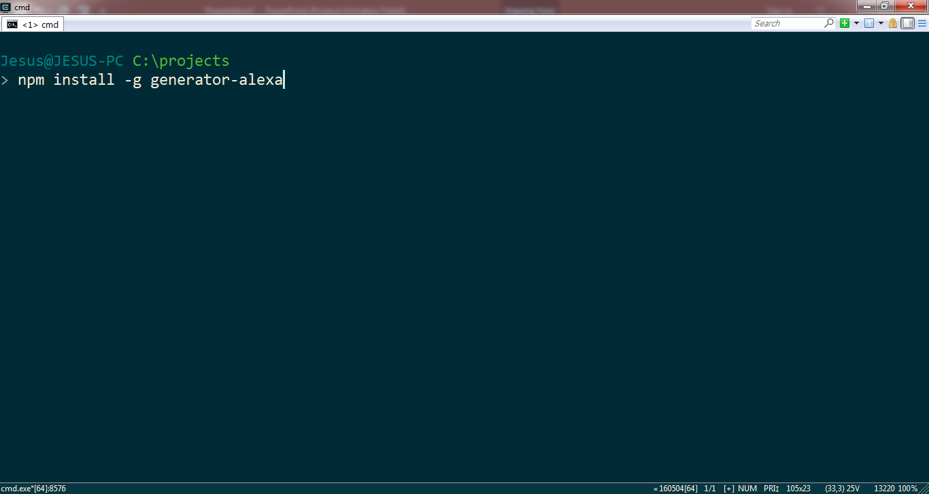
Now install the generator-alexa

Slide 26
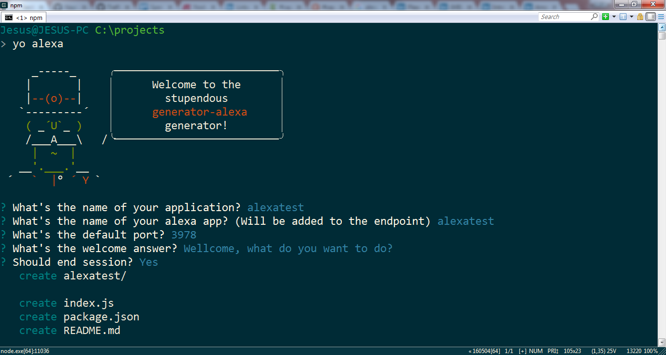
Create your app with yo alexa

Slide 27
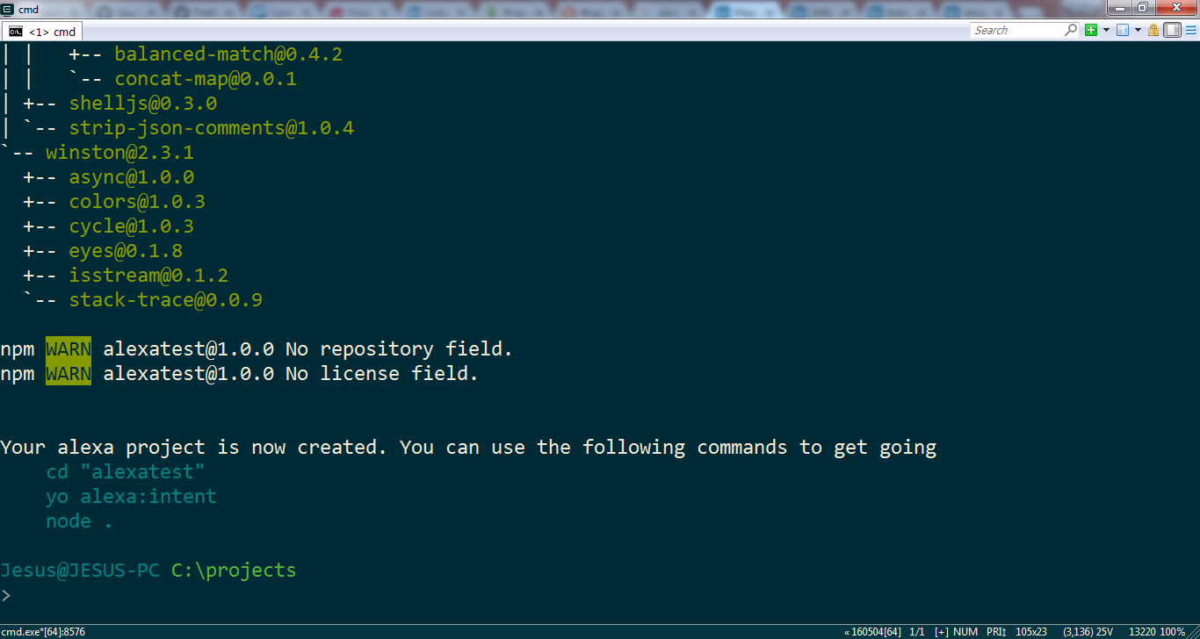
When it finish, you’ll see instructions.

Slide 28
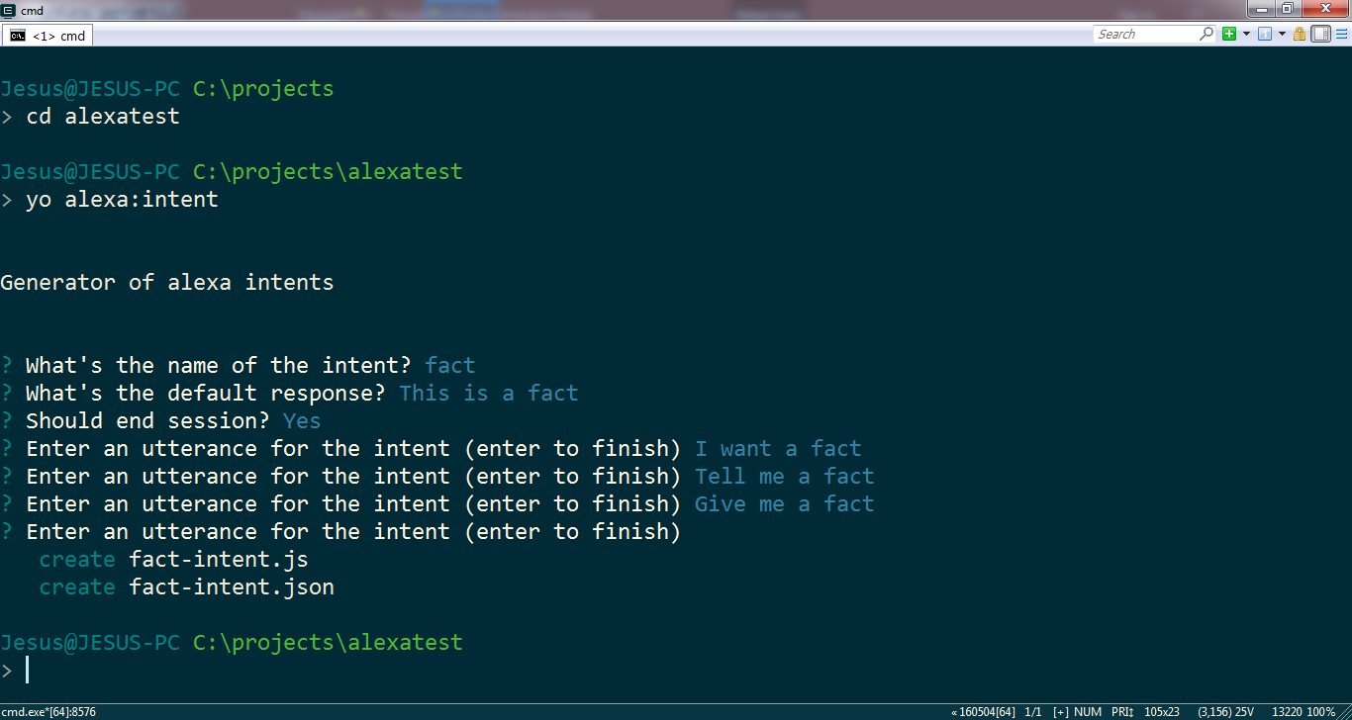
Now you have your first intent!

Slide 29
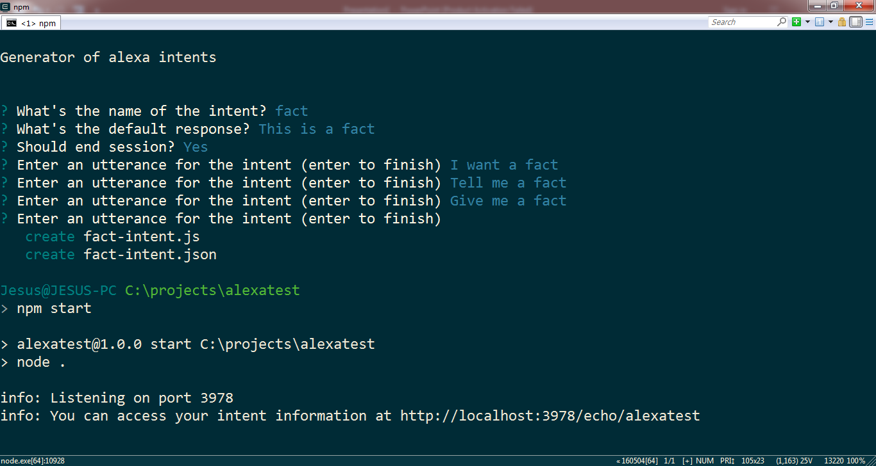
Run the app with ‘node .’ or ‘npm start’

Slide 30
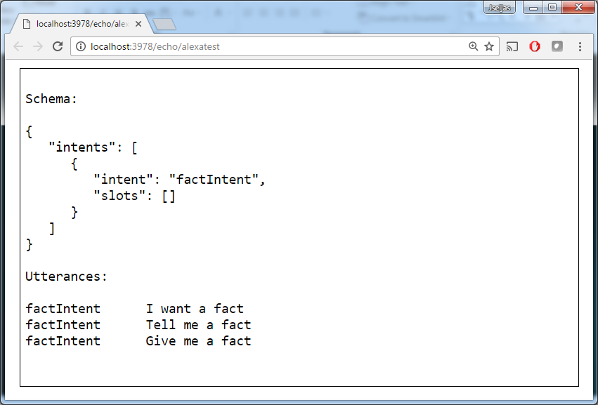
Visit the url

Slide 31
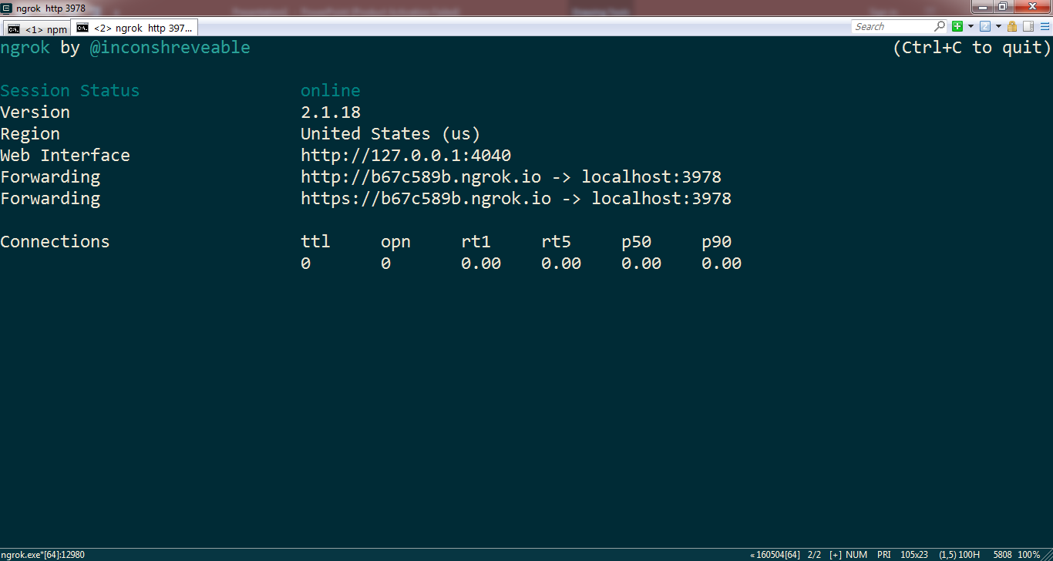
Time to create the tunnel with ngrok!

Slide 32
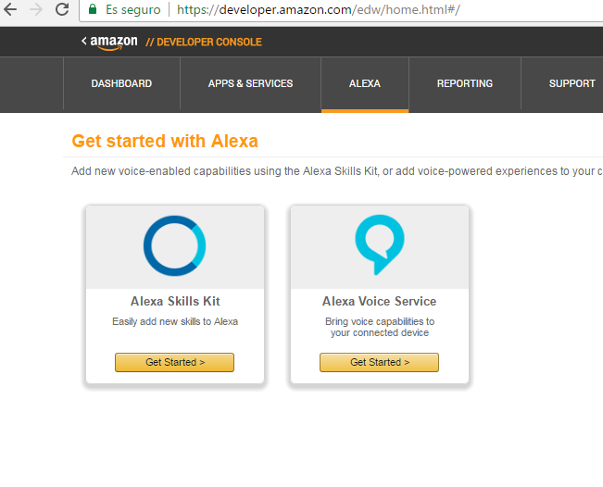
Go to your developer portal and
choose Alexa Skills Kit

Slide 33
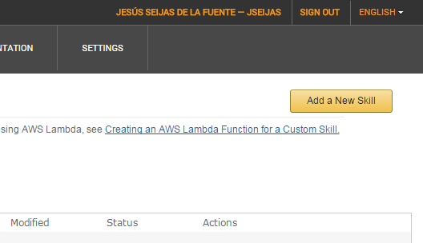
Click “Add a New Skill”

Slide 34
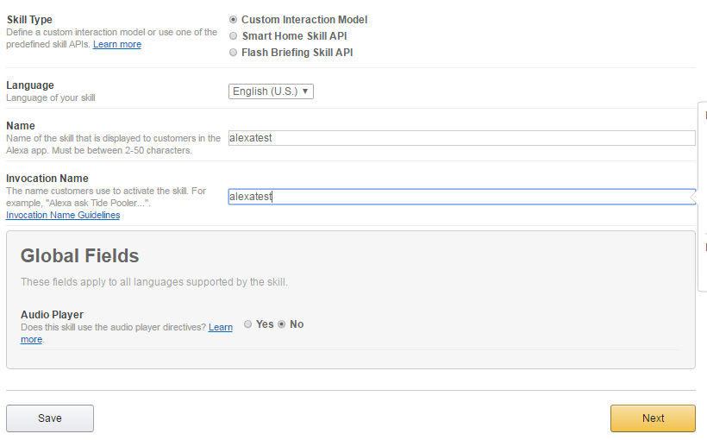
Basic information…

Slide 35
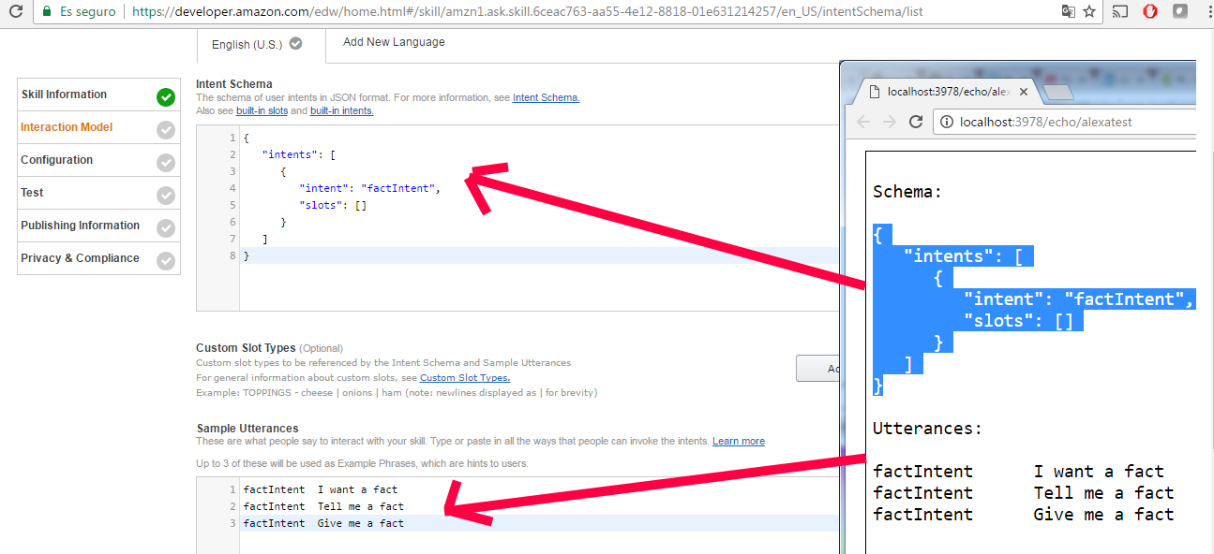
Copy/paste from your web

Slide 36
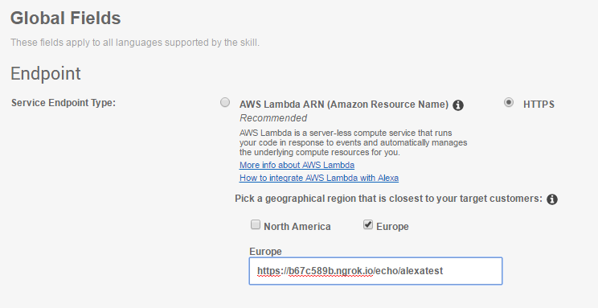
Fill with your ngrok https url, adding your
endpoint info (is in your service url)

Slide 37
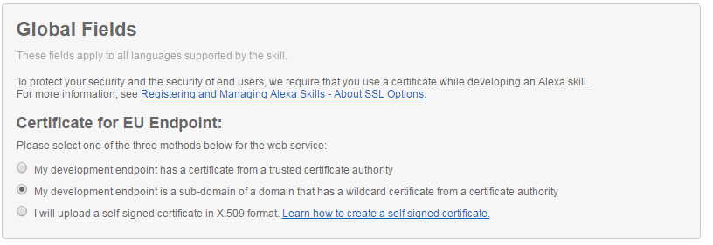
Second option in this case…

Slide 38
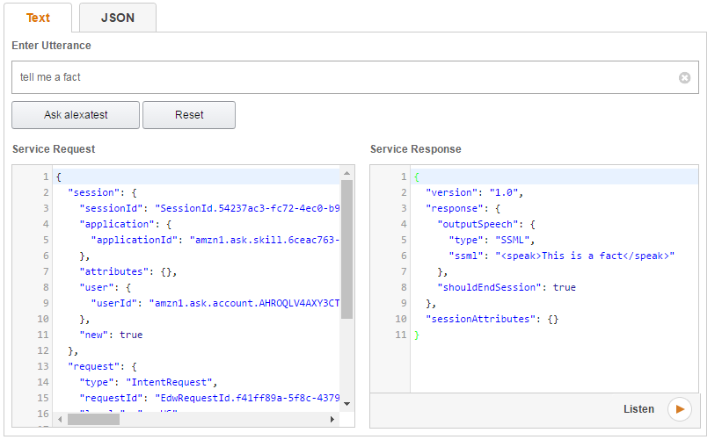
It’s done!!!! You can test!!!

Slide 39
That’s cool! I want to
deploy to Heroku!
Ok! Just create a github repository and
push your code
Go to the heroku dashboard and create
a new app
Go to the deploy tab, and connect it
to your github repo

Slide 40
Alexa, ask chucknorris
tell me a fact
When the Incredible Hulk gets angry
he transforms into Chuck Norris.
https://github.com/jseijas/alexa-chucknorris/
yo alexa:facts

Slide 41
Alexa, enter the
Dungeon!
This is a labyrinth experience. It’s an
Inmersive Application.
https://github.com/jseijas/alexa-dungeon/
You will need user context!

Slide 42
I want moaaaaar!!!!
https://developer.amazon.com/public/solutions/alexa/
alexa-skills-kit/docs/alexa-skills-kit-interaction-model-reference
https://github.com/alexa-js/alexa-app

